Slide 1

Optimize a Stock Portfolio using Deep Learning
Oai Tran – DS 7400
Date: 11/19/2025

Slide 2

Objective
Design a deep-learning-based framework for portfolio optimization and predictive trading.
Predict buy/sell signals and optimal entry prices using hybrid models:
Stage 1: LSTM for price forecasting
Stage 2: CNN + SVM for decision classification

Slide 3

Dataset and EDA
Data: S&P 500 (Top 7 / Bottom 7) vs. VOO benchmark (2017–2025).
Source: Yahoo Finance (yfinance API)
Period: Jan 2017 – Sept 2025
Features: OHLCV
Cleaning: Removed missing entries, non-trading days
Visualization: Candlestick charts, Bollinger bands (volatility clustering).

Slide 4
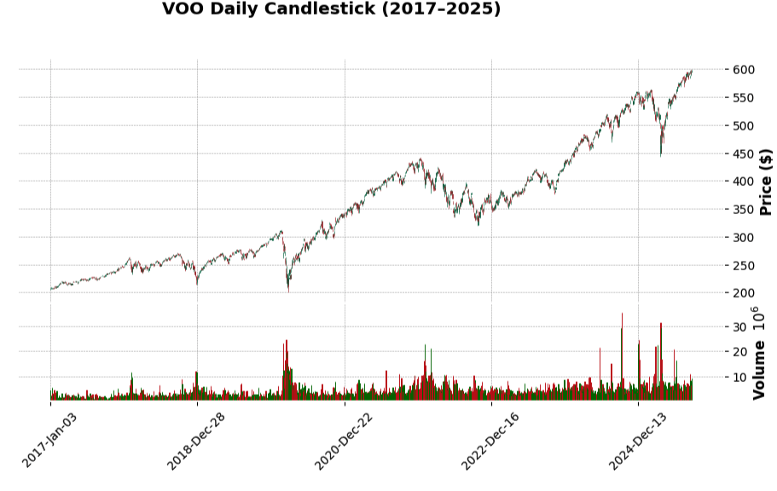
Visualization: Candlestick charts

Slide 5
Steps
1. LSTM prediction.
1
2.Use outputs from stage 1 as inputs for stage 2
2
3. Save models
3
4. Prediction
4

Slide 6
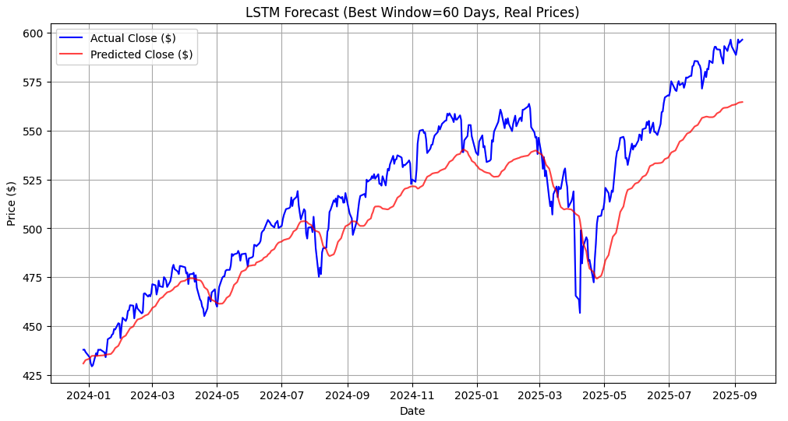
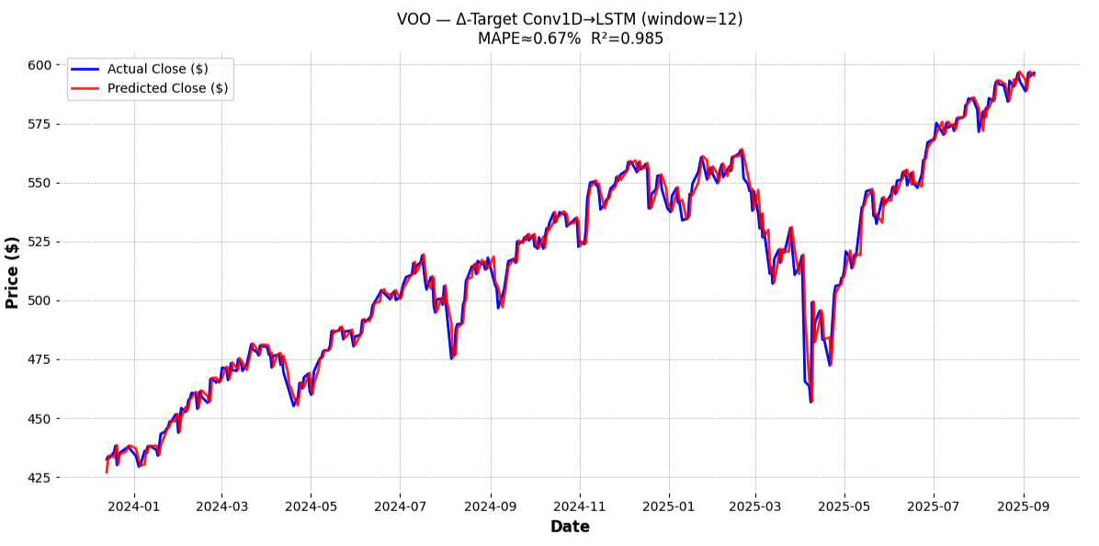
Stage 1 – LSTM Forecasting
Goal: Predict next-day prices.
Architecture: 2 LSTM layers (64 units) + Dropout(0.2) + Dense(32→1)
Input: Train data and use search best date [10,20,30,45,60] day OHLCV window
Metrics: MSE, MAE, correlation
LSTM showing positive trends
Add VIX

Slide 7
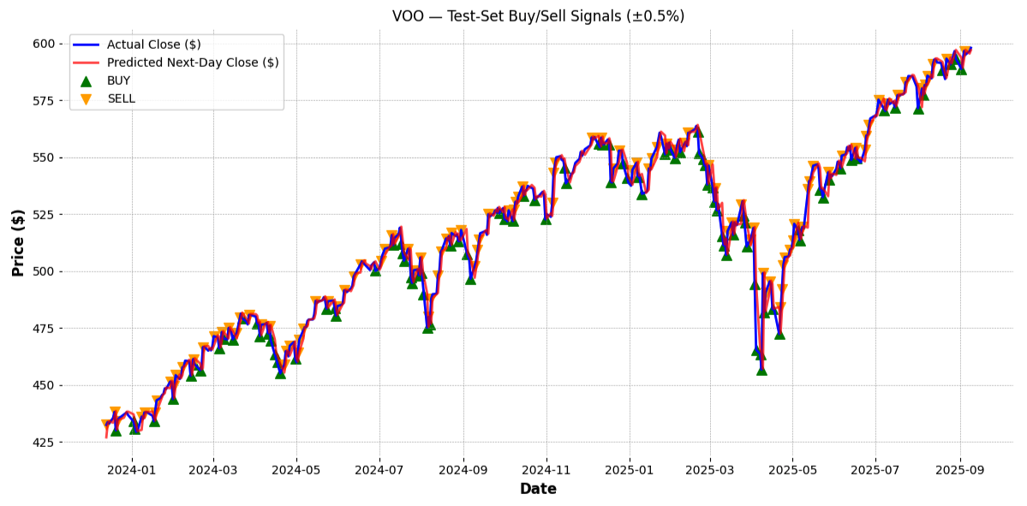
Stage 2 – CNN + SVM Decision Model
Goal: Improve decision margin and reduce overfitting.
Input: Candlestick images (past xx days) + LSTM predictions
Architecture: CNN feature extractor + SVM classifier
Output: Buy / Sell / Hold (±0.5% daily move)
Example

Slide 8
Live

Slide 9
References
B. Heaton, J. et al. “Deep Learning in Finance.” ArXiv.org, 2016, arxiv.org/abs/1602.06561.
Cohen, Naftali, et al. “Trading via Image Classification.” ArXiv.org, 2019, arxiv.org/abs/1907.10046. Accessed 15 Sept. 2025.
Feng, Guanhao, et al. “Deep Learning for Predicting Asset Returns.” ArXiv.org, 26 Apr. 2018, arxiv.org/abs/1804.09314.
Zhang, Cheng, et al. Deep Learning Techniques for Financial Time Series Forecasting: A Review of Recent Advancements: 2020-2022. 20 Apr. 2023, https://doi.org/10.48550/arxiv.2305.04811.
Cohen, Balch & Veloso (2019) – Trading via Image Classification Introduced the concept of converting time-series price data into candlestick images and using CNNs for trading signal prediction.
Zhang et al. (2017) – Stock Market Prediction via LSTM Networks Demonstrated how recurrent networks capture temporal dependencies in financial time series.
Selvin et al. (2017) – Stock Price Prediction Using LSTM, CNN, and RNN Compared hybrid architectures and found CNN-LSTM combinations to perform best for short-term forecasting.
Bao, Yue, & Rao (2017) – A Deep Learning Framework for Financial Time Series Using Stacked Autoencoders Illustrated unsupervised pretraining for robust representation of noisy market data.
Zhao et al. (2023) – Hybrid CNN-SVM for Stock Price Movement Prediction Proposed replacing the Softmax output layer in CNNs with an SVM classifier, improving boundary sharpness and generalization.

